Slide 1


Sankofa Learning Place LLC
Data Analysis

Slide 2
Table of Contents
Academic Support Analysis
Private Tutoring
Target Audience
Competitors
Learning Pods
Competitors
Recommendations
Private Tutoring
Learning Pods
Online Presence Analysis
Social Media
Areas of growth
Sankofa’s Journey
Website
Squarespace Analytics
Areas of Growth
Marketing & Advertising
Final Recommendations
Free & Fast Action Items
Notes:
Recom to change chapter 1 & chapter 2
Professional layout
Tasks as titles
subpoints - tasks

Slide 3
Academic Support
Private tutoring
&
Learning Pods

Slide 4
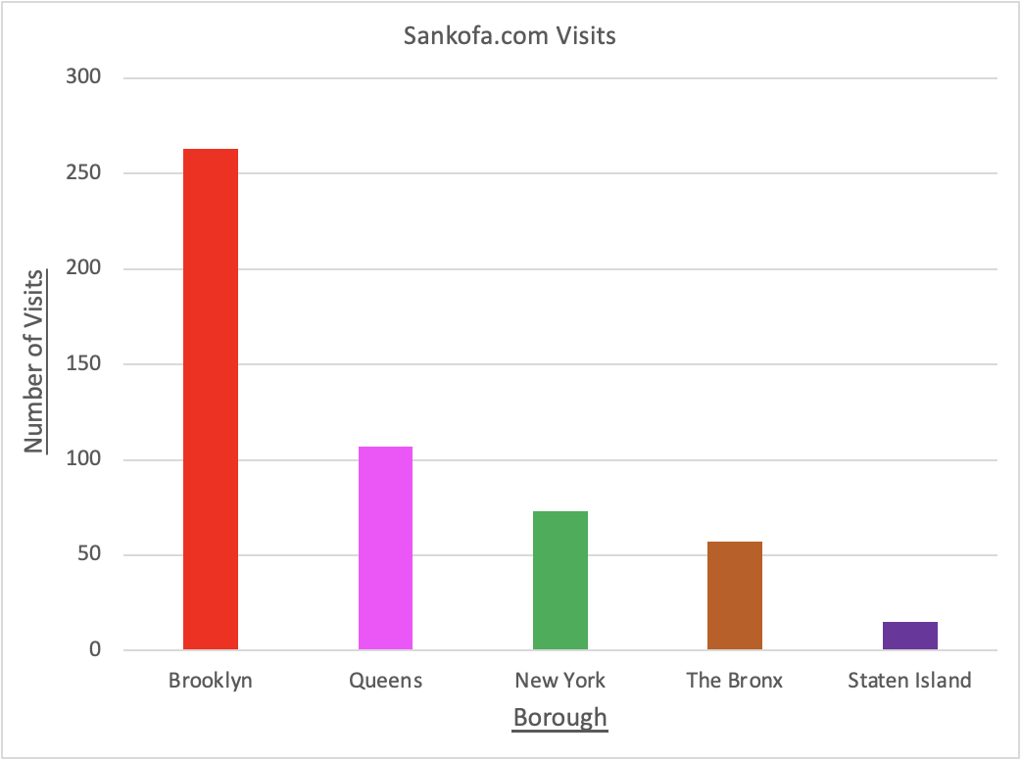
Target Boroughs
According to your website’s Squarespace analytics data, the borough of Manhattan has the third largest visits to Sankofa.com
Many who live in the high incomes areas of Manhattan can afford to pay your $60/ hr fee
There are 217 private schools serving 58,696 students in Manhattan. This can be a target audience for you to advertise to.
Notes:
Plenty of exposure and opportunities to expose Sankofa, with parents who may have kids in elementary school and high school.
This shows that you can have more clients and more income: Now ill pass it to Amanda for the specific target locations.

Slide 5
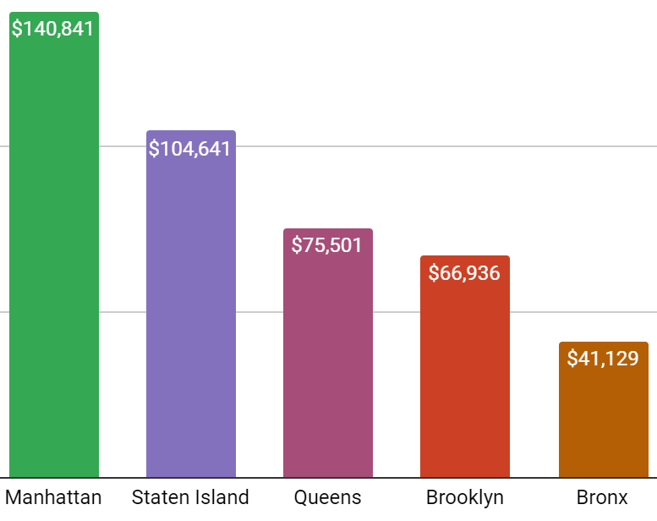
Target Neighborhoods
Facts about NYC Income
Affluent Neighborhoods to Consider
Tribeca
West Village, Soho & Little Italy
Brooklyn Heights & Cobble Hill
East Midtown
Upper East Side & Carnegie Hill
Borough
Sources: Community District profiles
2019 US Census on avg. family with children
2021 NYC’s affluent neighborhoods
Notes:
Interests, profiles - demographics (research for upper class)
Bc there is a connection with her most searched area (Brooklyn) and the highest income area, Manhattan. 7/9 from manhattan

Slide 6
Target Audience’s Age Range
According to the New York Times, the average age in NYC for first time mothers is about 31 as of a few years ago.
Your target audience are parents approximately
36 to 49 years old

Slide 7
Where can you connect with your
Target Audience?
Connect and interact with these parents on:
NY Metro Parents
Parents League
NY City Moms
Children’s learning centers like museums
Brooklyn Children’s Museum (Crown Heights)
Children’s Museum of Arts (below West Village)
Children’s Museum of Manhattan (Upper West Side)
Notes:
Amanda Parents of Young students
would there be more stay at home moms th or families that flee to vacation houses on weekends ?
Lululemon
Equinox

Slide 8
Strong Competitors
for
Private Tutoring

Slide 9

Smarthinking.com
Tutors are educators and professionals with an average of nine years’ experience in their subjects.
Smarthinking from Pearson offers a variety of subjects, from PreK-12 to higher education, with 24/7 online tutoring.
In addition to training and certification by Smarthinking, about 90% of tutors with this program have earned master’s degrees or Ph.D.s in their fields.
Many schools purchase Smarthinking for their students to use for free.
Pricing: 1 hour: $35 | 4 hours: $125 (valid for 4 months)

Slide 10

SpecialEdTutoring.com
All of the site's tutors have at least a Bachelor's Degree in special education
Students with special needs require tutors who understand their learning styles.
Tutors find that the students do well with online tutoring because they're in a comfortable and familiar setting (ie, home).
Rates start at $25/hour.

Slide 11
Competitor Tutoring Pricing:
Since 2013, Tutors.com has tracked thousands of cost estimates for every subject.
Here are the average tutoring prices in 2021:
Sankofa’s price range is higher than average at $60 per one-hour session.
In Person Private Tutoring | Online Tutoring | SAT and Test Prep | Tutoring Centers
$25 - $80/hr | $25 - $50/hr | $45 - $100/hr | $150 - $200/month
Notes:
https://tutors.com/costs In 2014, Tutor.com acquired The Princeton Review®, a world leader in test preparation, and added The Princeton Review test preparation services to its online tutoring platform. They work with CUNY SPS (School of Professional Studies) to provide students with one-on-one tutoring support. They also power tutoring and homework help programs for the Department of Defense: thousands of public libraries, school districts, colleges and universities; and the states of Alabama, Alaska, Louisiana, Montana, North Dakota, Rhode Island and the District of Columbia.

Slide 12
Learning Pod
Competitors

Slide 13

Parent-led pods:
Affordable since the teaching is split between community members
Parent-oriented curriculums like “Blossom and Root” make it possible for parents to create a rich learning experience for pod kids at home, without the need for an expensive investment into an official program or teacher.
The New York Public Library’s free online tutoring through Brainfuse can be used every day 2 - 11 p.m to assist kids who are learning together in a pod.
Notes:
The Price and Inequality of Learning Pods: Free and Cheap NYC Pod Resources
As you may have noticed, the price of micro-schooling can be very steep. This means that the safety and flexibility of learning pods is largely available only to those who can afford it. In fact, private "pandemic pods" can increase the inequality gap.
Luckily, if you're on a budget or simply can't afford the pricier options, there are ways to work with learning pods that are cheaper and more affordable. Parent-led pods can be very affordable since the teaching is split between community members. Here are a few more free or cheap options for NYC parents looking to participate in pod learning this fall:
The New York Public Library offers free online tutoring through Brainfuse every day 2 - 11 p.m. Although these resources are used one-on-one, they can support remote school learning and can be used to assist kids who are learning together in a pod. Tutoring is free and only requires a NYPL library card.
The United Federation of Teachers (UFT) has a "dial-a-teacher" program that helps kids K-5 with English and math work Monday through Thursday, 4 to 7 p.m. All you need to do is fill out a form and a call will be set up for you.
Free online curriculums like Khan Academy and affordable, parent-oriented curriculums like Blossom and Root make it possible for parents to create a rich learning experience for pod kids at home, without the need for an expensive investment into an official program or teacher.
Free and affordable online courses are another option, with websites like Udemy, Sawyer, and many local museums offering many different skills with video instruction and assignments.
Free and affordable live virtual classes take this idea a step further with live instruction - perfect for pods! The 92Y, for instance, has lessons on everything from hip-hop and tap dancing to science and art. Varsity Tutors also hosts live virtual classes, some of which are fairly affordable (and be on the lookout for occasional free courses!).
https://tinybeans.com/new-york/nyc-pandemic-learning-pods-micro-school-options/slide/6
https://dialateacher.org/

Slide 14
Free and affordable live virtual classes
Take this idea a step further with live instruction - perfect for pods
The 92Y has virtual lessons on everything from hip-hop and tap dancing to science and art.
Varsity Tutors also hosts live virtual classes, some of which are fairly affordable
Notes:
The Price and Inequality of Learning Pods: Free and Cheap NYC Pod Resources
As you may have noticed, the price of micro-schooling can be very steep. This means that the safety and flexibility of learning pods is largely available only to those who can afford it. In fact, private "pandemic pods" can increase the inequality gap.
Luckily, if you're on a budget or simply can't afford the pricier options, there are ways to work with learning pods that are cheaper and more affordable. Parent-led pods can be very affordable since the teaching is split between community members. Here are a few more free or cheap options for NYC parents looking to participate in pod learning this fall:
The New York Public Library offers free online tutoring through Brainfuse every day 2 - 11 p.m. Although these resources are used one-on-one, they can support remote school learning and can be used to assist kids who are learning together in a pod. Tutoring is free and only requires a NYPL library card.
The United Federation of Teachers (UFT) has a "dial-a-teacher" program that helps kids K-5 with English and math work Monday through Thursday, 4 to 7 p.m. All you need to do is fill out a form and a call will be set up for you.
Free online curriculums like Khan Academy and affordable, parent-oriented curriculums like Blossom and Root make it possible for parents to create a rich learning experience for pod kids at home, without the need for an expensive investment into an official program or teacher.
Free and affordable online courses are another option, with websites like Udemy, Sawyer, and many local museums offering many different skills with video instruction and assignments.
Free and affordable live virtual classes take this idea a step further with live instruction - perfect for pods! The 92Y, for instance, has lessons on everything from hip-hop and tap dancing to science and art. Varsity Tutors also hosts live virtual classes, some of which are fairly affordable (and be on the lookout for occasional free courses!).
https://tinybeans.com/new-york/nyc-pandemic-learning-pods-micro-school-options/slide/6
https://dialateacher.org/

Slide 15
Recommendations for improvement for
private tutoring & learning pods
Private Tutoring
Focus on the parents of any age that want 1-on-1 help for their kids AND can afford it.
Learning Pods
Focus on the parents of younger students.
Focus on parents of students who can benefit from time with groups of their peers.
Focus on parents who may want a more economic option.
Customer Retention
Knowing her clientele
Entry & Exit surveys
Educational Inclusion
SAT/ACT Test Prep
College Prep Courses
Higher Education Test Prep
Data / Record- Keeping
Notes:
Jaleesa - streamlined version.
Inessa(left)
private tutoring should focus on parents who can afford and want 1 on 1
Learning pods, on the other hand, are more economic options. We think you should focus on parents who think their kids can benefit from working with their peers. We think that you should focus on the parents of the younger half of your students, because high schoolers have work that is more specialized and may need more individual attention.

Slide 16
Online Presence
Social Media Website Marketing & Advertising

Slide 17
Social Media Metrics
(Save for later)
Engagement
Gives an idea of who is interacting with Sankofa and its content
Sentiment
What people feel about Sankofa and its brand
Impressions
The # people viewed your posts/ads
Followers
How many people subscribe to / keep up with Sankofa
Share of Voice (SOV)
How many people are talking about Sankofa compared to other tutoring services in the market
Notes:
Tommy/Shahariar :p
Sessions & activity - Cost, length, resources and progress of students are all quantifiable data.
Revenue- Willingness to spend more to provide students with more resources and materials, expand to more locations, hire more teachers, more sessions, etc.
Reviews on Website- Set in place a measurement framework to display success and progress metrics
Bounce Rate/CTR- These metrics will both give an idea as to how effective the site is for who we are targeting and conversely what we can change about the site to fit the needs of the target audience
Lead Generation via Email Collection- **ask if this is okay first in order to market to parents**

Slide 18
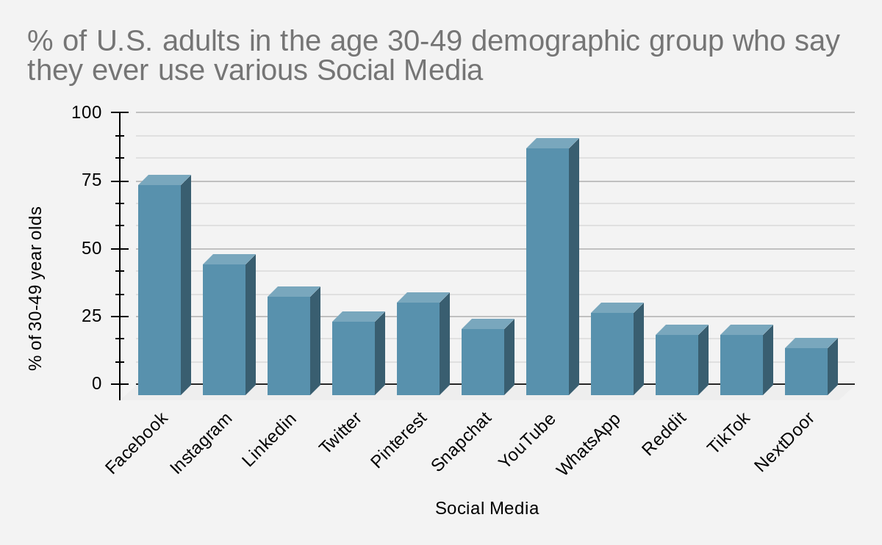
What Social Media should Sankofa focus on?
Your target audience uses Youtube, Facebook, and Instagram the most
Facebook is where most of your current website traffic comes from.
The chart on the right shows YouTube being the top social media used at 91% for this age range.
Sources:
https://www.pewresearch.org/internet/fact-sheet/social-media
https://www.pewresearch.org/internet/fact-sheet/social-media
Notes:
Inessa:
But which forms of social media would be the best way to reach the parents? According to the New York Times, the average age in NYC for first time mothers is about 31 as of a few years ago. The parents are close to the range of 36 to 49 give or take a few years. Looking at the Pew Research data about Social network use, this age demographic uses YouTube, Facebook, Instagram the most. Facebook is also where most of your current website traffic comes from. We were most surprised to see that YouTube topping the chart at 91%, so it would be a good idea to use YouTube as one of the Social Media accounts for the company, with the possibility of cross posting. It would also help with the personalization, for the parents to get to know bits either about you and your tutors or about the teaching styles used.
----------------
Notes:
zhttps://www.statista.com/statistics/471370/us-adults-who-use-social-networks-ag
https://www.pewresearch.org/internet/fact-sheet/social-media ~ which social medias they use
https://www.statista.com/statistics/471370/us-adults-who-use-social-networks-age/
The parents are close to the range of 36 to 49 give or take a few years. (can add article for reference)
According to the New York Times, the average age in NYC for first time mothers is about 31 as of a few years ago. Kids start Kindergarten around age 5 usually and the average age at graduating high school is about 18 years old. We can ascertain that the parents are close to the range of 36 to 49 give or take a few years. This puts them in the older Millenials and younger half of Gen X group.
The article also talks about how it's those with a higher socioeconomic status that delay childbirth and that’s part of why we increased to these ages. There is a decline in teen births with a rise in use of various methods of birth control, all affecting these ages.
https://www.nytimes.com/interactive/2018/08/04/upshot/up-birth-age-gap.html

Slide 19

Sankofa’s Areas for Growth:
Social Media
Social Media:
A separate intern just for Social Media
Content Posts/Ads
Giveaways (more client interactions)
‘Back-to-School’ supply baskets
Books/Materials giveaways
Notes:
Inessa:
We took a look around available materials to see the areas for growth. The current social media has very few posts, Facebook with only 13 likes, 13 followers, 0 reviews and Instagram with 1 post, 17 followers.
First things first, more social media posts and social media exposure would help build your online presence which can help with exposure.
Cross posting content and interacting with people online is a big part of it. You can do a giveaway to help with traction, make sure to answer peoples’ comments. We think that you should try to get a second intern just for social media, maybe a college student with a good grasp of the english language and grammar.
Consistent color scheme that translates to all media, using the logo on social media posts, and making sure posts have good grammar will all appear more professional. Of course, this applies to any customer facing online presence.

Slide 20

Sankofa’s Areas for Growth:
Social Media
Accessibility
High contrast colors in images and text/image contrast (text visibility over images)
Captions and Video Transcripts
#CamelCaseHashTags (written with Upper Case Letters)
Notes:
Inessa:
As inclusiveness is important to the company, we suggest the use of accessibility features in all posts moving forward. We can provide a guide that we are working on which will cover this in more detail.
This includes contrasting colors when posting an image where you add text over it, having transcripts for any videos you make in the future, and making it readable by screen readers.

Slide 21







Sankofa’s Journey
Help people to discover you.
Upkeep of social media
Social Media → Website
Informed potential customers
Convince them to try your services
Free lesson/trial
Put your best foot forward
Once you have the customers, show them why your services are the best.
Customer appreciation
Discount for return customers who leave a Yelp review
Notes:
As Jaleesa mentioned earlier, marketing your business is integral for your success. The marketing funnel starts out with awareness. You’re working towards starting the first phase and need to set up the Social media. Of the views you do have on your Squarespace site, most are coming from Facebook. Imagine what can happen if you set up and cultivate the social media presence.
The social media will lead more people to the web site, where you can inform them about your business. Without this, you won’t be able to convince them to try your services. You need a following to advertise, where you can use some kind of promo to hook the customer into trying. You can’t have that opportunity to engage the customers and put your best foot forward unless you start attracting customers and bringing awareness to your brand.
We are hoping that you don’t overlook the power of social media and just how important it is to integrate social media and marketing/advertising with the website to get the customer there and to continue to retain the customer. You can offer incentives like discounts for returning customers who leave a good Yelp review.
I’m going to pass it along to my classmates to talk to you a bit more about the next part of web presence, the web site.

Slide 22
Website

Slide 23

Website Metrics
(Save for later)
Sessions/Site Visits
The number of times people are visiting the Sankofa website
Bounce Rate
The ratio of people who go to Sankofa’s website and leave without interacting with the site
Return on Investment (ROI)
How much revenue is being generated vs. the costs
Positive Reviews
Implementing a 5-star system on the website could build trust in Sankofa’s brand
Conversions/ Conversion Rate (CVR)
Number of tutoring sessions booked and the ratio that with how many people see your post/ads
Notes:
Tommy/Shahariar :p
Sessions & activity - Cost, length, resources and progress of students are all quantifiable data.
Revenue- Willingness to spend more to provide students with more resources and materials, expand to more locations, hire more teachers, more sessions, etc.
Reviews on Website- Set in place a measurement framework to display success and progress metrics
Bounce Rate/CTR- These metrics will both give an idea as to how effective the site is for who we are targeting and conversely what we can change about the site to fit the needs of the target audience
Lead Generation via Email Collection- **ask if this is okay first in order to market to parents**

Slide 24
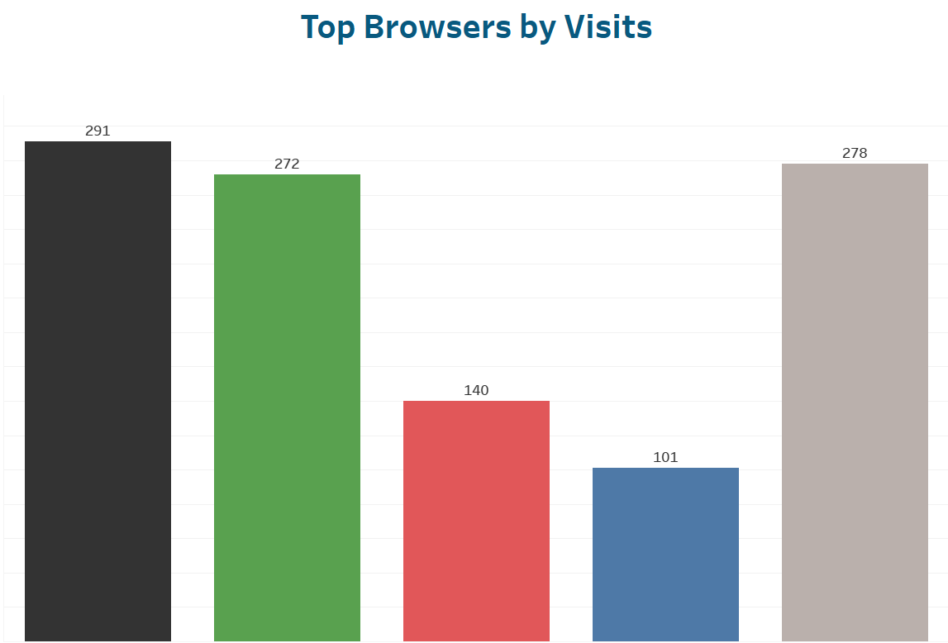





Utilization of data - Squarespace Analytics
Squarespace can be a great platform for SLP to obtain day-to-day website tracking information
Traffic Calculation
Audience Demographics
Social media platforms
Popular Content
Activity log
Notes:
Traffic Calculation - Squarespace analytics can tell you the number of visitors on your website minus the number of visits you make (internal traffic)
Audience Demographics - Analytics can help them find out the place of their audience. They will know where in the world the people visiting their website are located.
-shahariar

Slide 25

Areas of Growth: Data Collection
Documentation of sessions, assessments, progress of students
Feedback to measure success
Create surveys (Google Forms) to access data about parents and students (demographics)
Website traffic and customer insights

Slide 26
Marketing &
Advertising

Slide 27
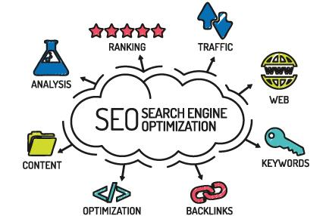
Marketing
Personalization:
Personal pictures & teacher information
Allows website to be viewed as welcoming
Content Marketing:
Social Media
Videos of lessons, FAQ’s
Webinars (for teachers)
Search Engine Optimization (SEO)
FREE
Works directly with Content Marketing
Notes:
Jaleesa
Content Marketing:
SEO -
Sankofa’s business is not claimed on search engines
Search engine Optimization for organic search.
Free Resources for SEO tools to make Sankofa easily accessible
Could get your business in the number one spot when a user searches a particular keyword.
Varies site to site but generally you would create a business user account and then verify that you own your business.
You could Update & enhance business, respond to reviews
some search engine sites offer data insights as well
https://blog.hubspot.com/marketing/marketing-types
“SEO and content marketing can generate fantastic results when utilized correctly and this is why:
SEO can prepare your website and make it easily accessible to search engine and users
When you publish new content, search engines will pick it up and use it in their index
Gradually this will increase your organic traffic and then you can use content again to convert visitors into customers.
Great content will also make your website sharable on social media and this will get you more traffic and exposure
Great content will also attract links from other websites and this will have a positive effect on off-page SEO which means higher ranking positions and more organic traffic”
https://www.reliablesoft.net/difference-between-seo-and-content-marketing-explained-in-simple-terms/

Slide 28
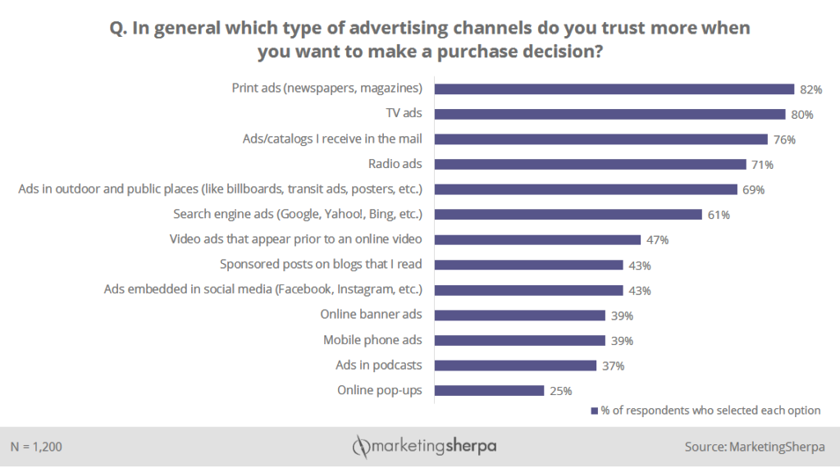
Advertising
Print Advertising is still the most trusted
Online Advertising
Free tutorials
Live Sessions (Customer Engagement)
Blog Advertising
Growing and reaching ten of millions of readers
MarketingSherpa
Notes:
Advertising:
Missing out on the benefits of standard “old” school paper advertising.
Print Advertising is still relevant in todays time. So it would be a good idea to print and post flyers
there are probably more small businesses per block than any other borough in Booklyn.
So flyers should be posted on every bulletin and community board thee is in places such as: Coffee Shops, Grocery Stores, laundromats, community centers ect.
Online Advertising:
Youtube/Videos
YouTube page highlighting yours and the other teacher’s teaching styles and a promotional videos distributed on online channels.
Free tutorials for for perspective customers could go a long way with highlighting how your learning center is different from any other one or diffrentiating why parents should book you and your company to teach their special needs children
Live
Go live on various social sites,
Host events to boost customer engagement such as:
introductory business informationals, Q & A events with Maat and her teachers, or short interactive teaching sessions
Blog advertising
“In spite of being the oldest category of influencers, blog audiences are still growing and reaching tens of millions of readers”
https://www.convinceandconvert.com/content-marketing/blog-advertising/
Podcasts:
Free to create and free to listen to
It has been “found that 61% of listeners purchased a product or service after hearing it advertised on a podcast.”
https://www.shopify.com/blog/34911301-how-to-start-a-podcast-the-ultimate-step-by-step-podcasting-guide#:~:text=Whether%20you're%20looking%20to,and%20free%20to%20listen%20to.
“Smart speaker ownership overall increased by 22% between 2020 and 2021.”
https://www.convinceandconvert.com/content-marketing/podcast-statistics-charts-and-data/

Slide 29
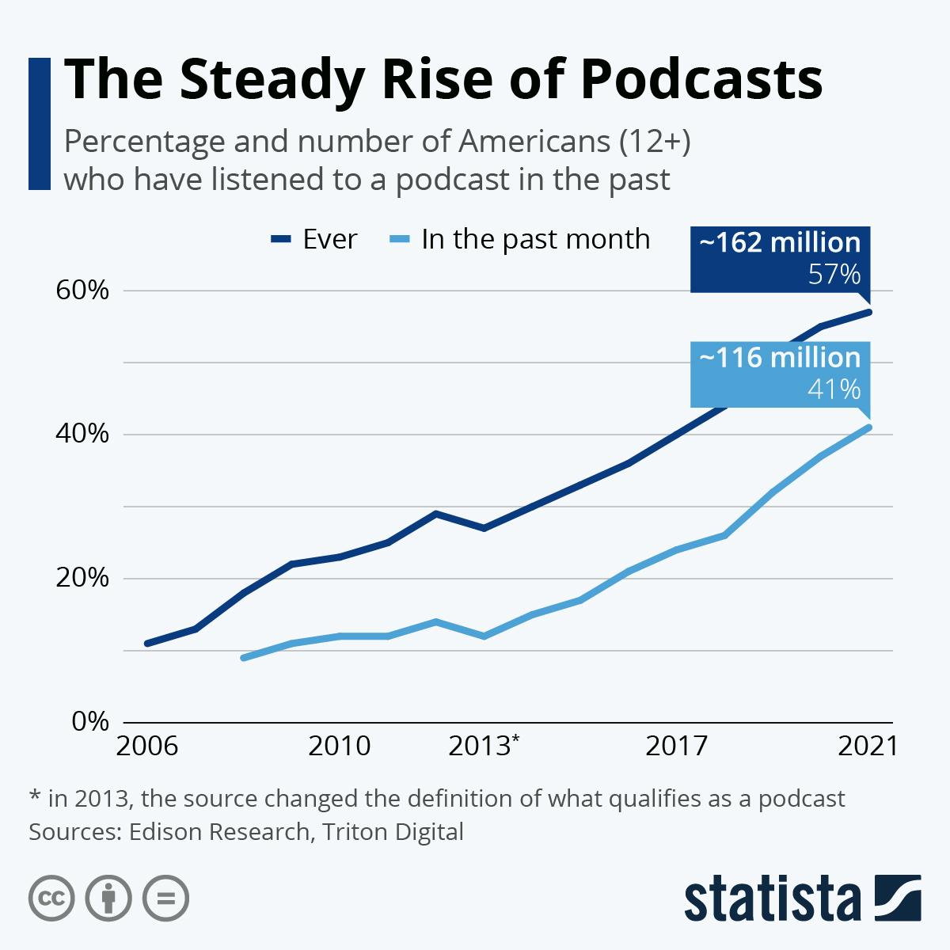
Advertising (Cont’d)
Podcasts (Parent teaching tips)
61% of listeners purchased a product or service after hearing it advertised on a podcast
The Steady Rise of Podcasts - Statista.com

Slide 30
Immediate
Action to take right now

Slide 31
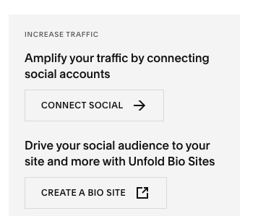
Free & Fast Action Items
Hire a marketing apprentice from Acadium.com to help you build your online presence & set up your SEO
Increase your website traffic by connecting your social media accounts on Squarespace
Drive your social media audience to your website and more with “Unflod Bio site”

Slide 32
Free & Fast Action Items
(Cont’d)
Create free surveys on “Google Forms” to get feedback on future clients
Look up the best parenting podcasts & do a feature on your social media called “Podcast Friday’s” and feature 1 good episode a week.
Take a professional picture of yourself to showcase online.
Look at what your 2 biggest competitors are doing to attract customers.
1. Slides 6 - Smarthinking.com
2. Slide 7 - SpecialEdTutoring.com
Create short videos of your teachers doing a mini-lesson (students not needed in video) to demonstrate teaching style & staff experience.

Slide 33
Thank you!
Please let us know if you have any questions

